Slide 1
Fuzz Testing Overview
AVCDL-Implementation-10.1
Charles Wilson
Staff Product Cybersecurity Architect
version 3
2026-05-04
Notes:
Script:
I'm Charles Wilson, staff product cybersecurity architect at Torc Robotics.
This presentation will cover an overview of Fuzz Testing.

Slide 2
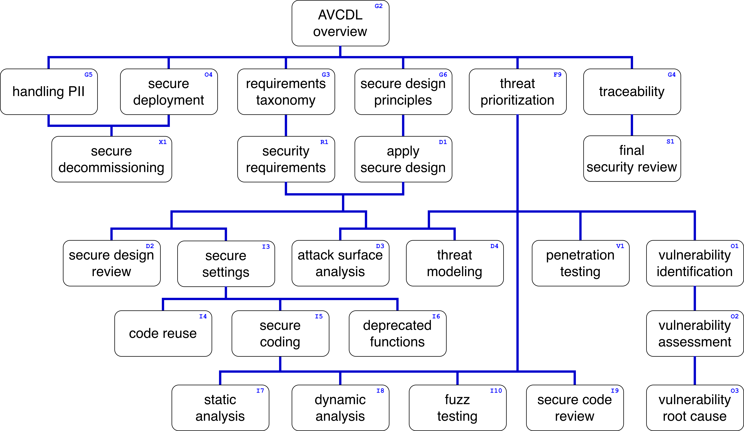
Training Path
Notes:
Script:
This diagram shows the overall AVCDL training path.
If you're taking this training, it's assumed that you've already completed the AVCDL Overview training,
and additionally, that you've completed the
Requirements Taxonomy
Security Requirements
Secure Design Principles
Apply Secure Design
Threat Prioritization
Secure Settings
and
Secure Coding
trainings.
This training will cover an overview of Fuzz Testing.

Slide 3
Introduction
Notes:
Script:
When we think about testing generally, and unit testing specifically, we tend to do so the same way we think about the creation of the code itself.
[break]
We treat testing like a structured process, not unlike the chess board shown here.
If we look at unit testing as our basis,
what we're doing is looking at a single aspect of an element and verifying that it behaves the way we expect it to.
We focus on boundary conditions.
Does it handle specific good cases and specific bad cases as expected?
[pause]
Fuzz testing is a different beast.
In fact, although we performed fuzz testing before it had a name, which didn't come along until the late 1980s,
we still applied its core mechanism, which is to utilize randomized input data.
Unlike our unit test analog of a chessboard,
[break]
fuzz testing is more like a roulette wheel.
The modern approach to fuzz testing takes seed inputs that we know are correct,
mutates them, and then in an automated fashion,
feeds those inputs into the specific functions under consideration,
seeing how the system responds.
[pause]
There's a whole lot more that goes on here, but that's basically what's happening.
It is unlike most of our other approaches to testing.

Slide 4

Introduction *
* Setup at the start of a chess game (link in references)
Notes:
Script:
When we think about testing generally, and unit testing specifically, we tend to do so the same way we think about the creation of the code itself.
[break]
We treat testing like a structured process, not unlike the chess board shown here.
If we look at unit testing as our basis,
what we're doing is looking at a single aspect of an element and verifying that it behaves the way we expect it to.
We focus on boundary conditions.
Does it handle specific good cases and specific bad cases as expected?
[pause]
Fuzz testing is a different beast.
In fact, although we performed fuzz testing before it had a name, which didn't come along until the late 1980s,
we still applied its core mechanism, which is to utilize randomized input data.
Unlike our unit test analog of a chessboard,
[break]
fuzz testing is more like a roulette wheel.
The modern approach to fuzz testing takes seed inputs that we know are correct,
mutates them, and then in an automated fashion,
feeds those inputs into the specific functions under consideration,
seeing how the system responds.
[pause]
There's a whole lot more that goes on here, but that's basically what's happening.
It is unlike most of our other approaches to testing.

Slide 5

Introduction *
* Roulette ball (link in references)
Notes:
Script:
When we think about testing generally, and unit testing specifically, we tend to do so the same way we think about the creation of the code itself.
[break]
We treat testing like a structured process, not unlike the chess board shown here.
If we look at unit testing as our basis,
what we're doing is looking at a single aspect of an element and verifying that it behaves the way we expect it to.
We focus on boundary conditions.
Does it handle specific good cases and specific bad cases as expected?
[pause]
Fuzz testing is a different beast.
In fact, although we performed fuzz testing before it had a name, which didn't come along until the late 1980s,
we still applied its core mechanism, which is to utilize randomized input data.
Unlike our unit test analog of a chessboard,
[break]
fuzz testing is more like a roulette wheel.
The modern approach to fuzz testing takes seed inputs that we know are correct,
mutates them, and then in an automated fashion,
feeds those inputs into the specific functions under consideration,
seeing how the system responds.
[pause]
There's a whole lot more that goes on here, but that's basically what's happening.
It is unlike most of our other approaches to testing.

Slide 6
Approach
Notes:
Script:
Like most of the activities we undertake in cybersecurity, fuzz testing is not inherently cybersecurity specific.
Fuzz testing is a methodology.
[pause]
So how do we use fuzz testing In a cybersecurity context?

Slide 7
Cybersecurity Approach
Focus on cybersecurity-relevant elements
Guided by attack surface analysis
Notes:
Script:
Our approach to fuzz testing, from a cybersecurity perspective is straightforward.
We're going to
[pause]
focus on cybersecurity-relevant elements.
If we were to simply take any element of the system and perform fuzz testing on it, it would almost certainly expose issues.
The vast majority of those issues (although valid) are not going to be cybersecurity-relevant.
And because cybersecurity teams are small, it's important to concentrate the efforts of the cybersecurity team on those areas which they are most qualified to be able to address.
[pause]
How do we establish which elements are cybersecurity relevant?
[pause]
We guide that by using the results of the attack surface analysis process.
It’s this analysis which identifies the system’s cybersecurity-relevant elements.

Slide 8
Workflow
Notes:
Script:
With the background material out of the way, we'll now look at the workflow involved in the fuzz testing process and then examine each of the activities it contains.

Slide 9
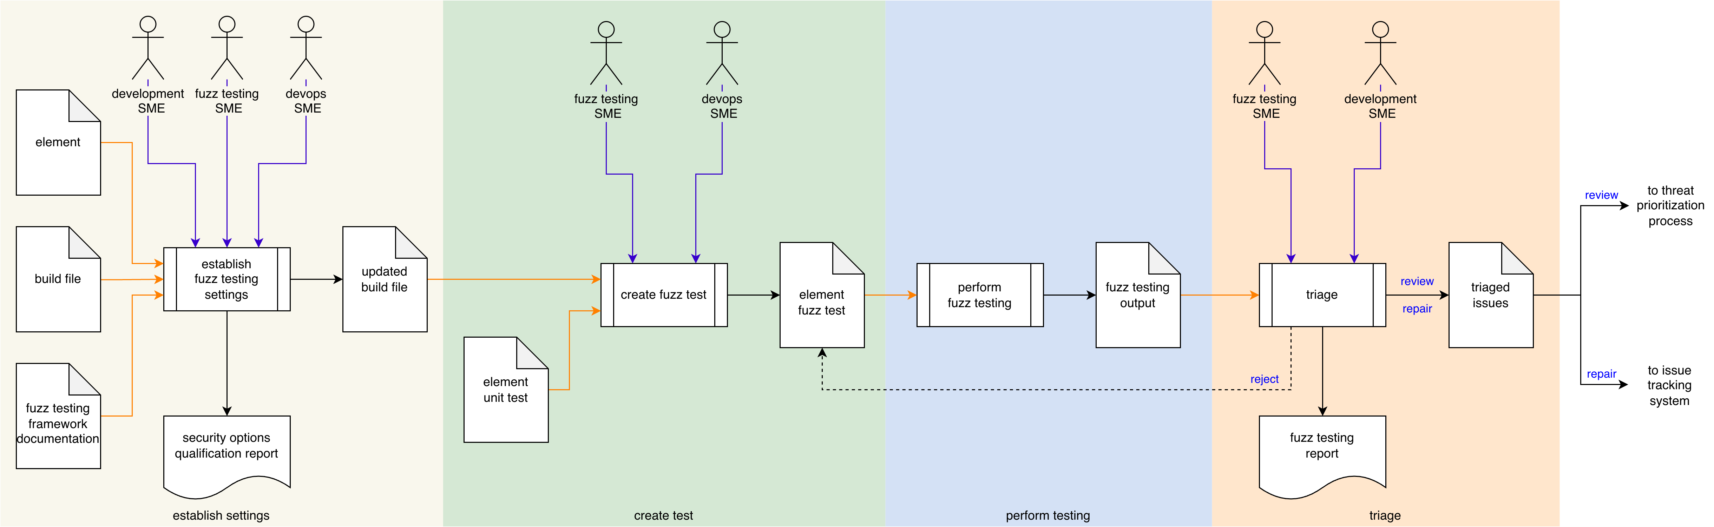
Process Workflow
Notes:
Script:
The workflow for performing the fuzz testing process is broken down into four discrete activities.
These are:
• establishing the cybersecurity relevant settings
• creating the test
• performing the testing
and finally
• conducting a triage of the issues identified as a result of the testing

Slide 10
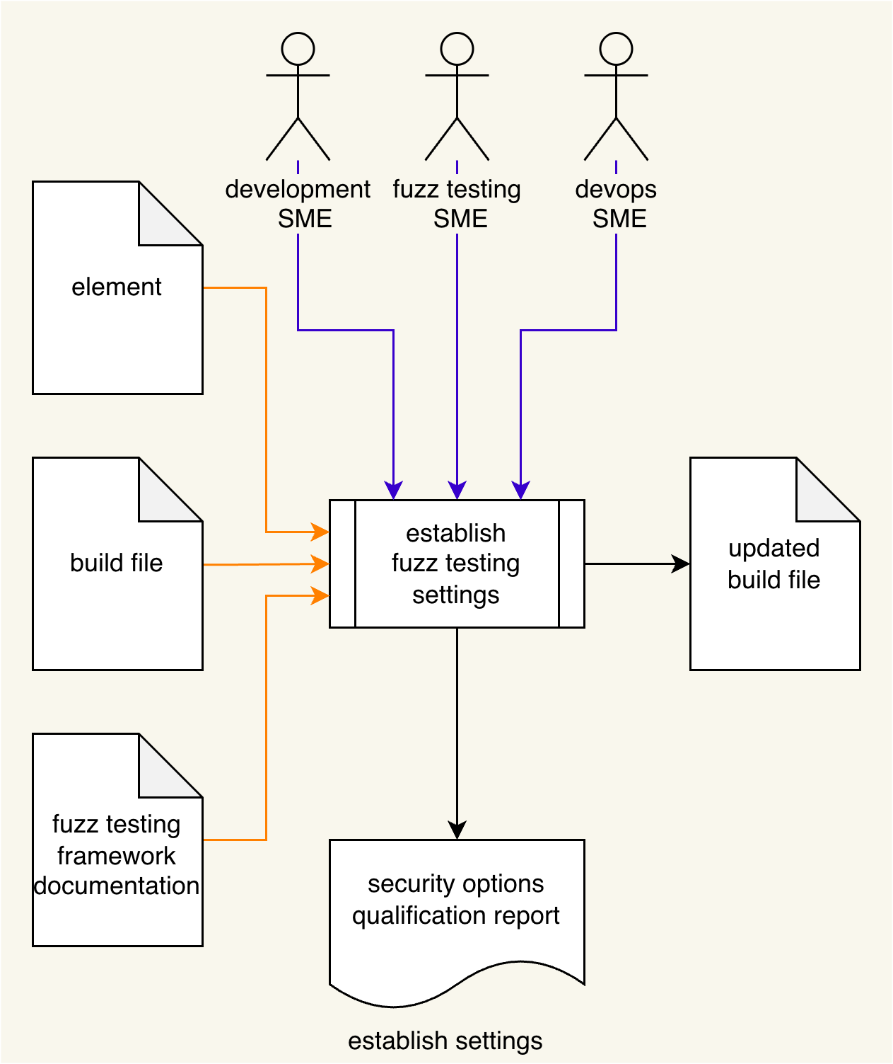
Process Workflow
Notes:
Script:
The workflow for performing the dynamic analysis process is broken down into four discrete activities.
These are:
• establishing the cybersecurity relevant settings
• instrumenting the element
• performing the analysis
and finally
• conducting a triage of the issues identified as a result of the analysis

Slide 11
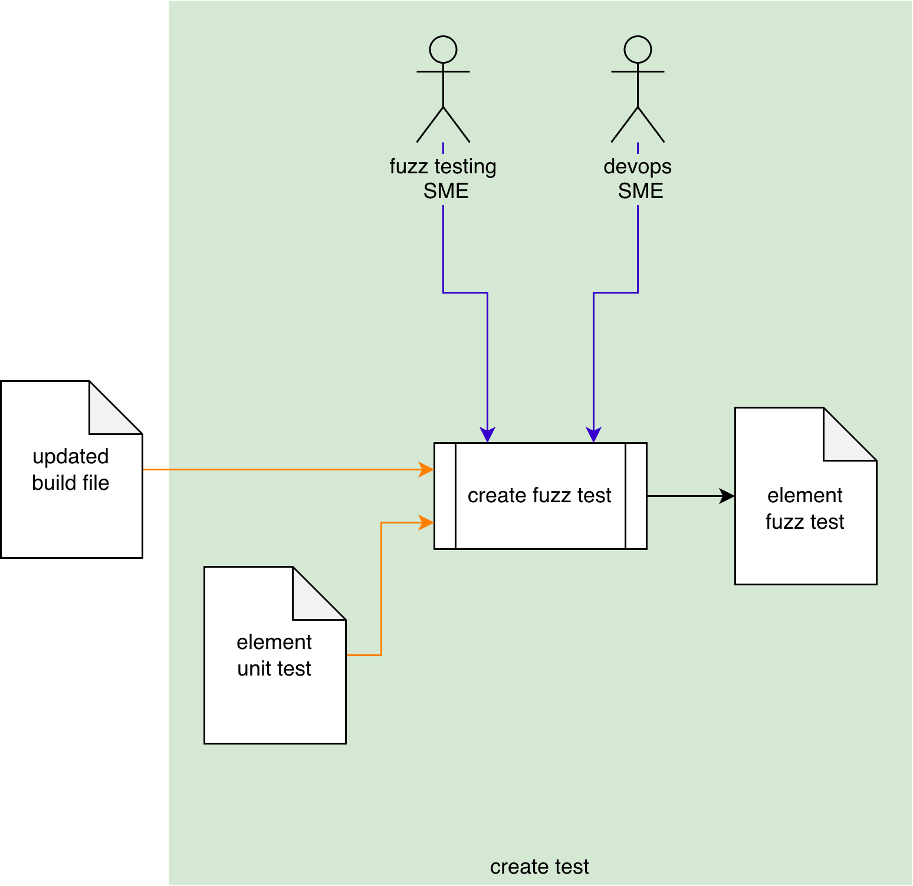
Process Workflow
Notes:
Script:
The workflow for performing the dynamic analysis process is broken down into four discrete activities.
These are:
• establishing the cybersecurity relevant settings
• instrumenting the element
• performing the analysis
and finally
• conducting a triage of the issues identified as a result of the analysis

Slide 12
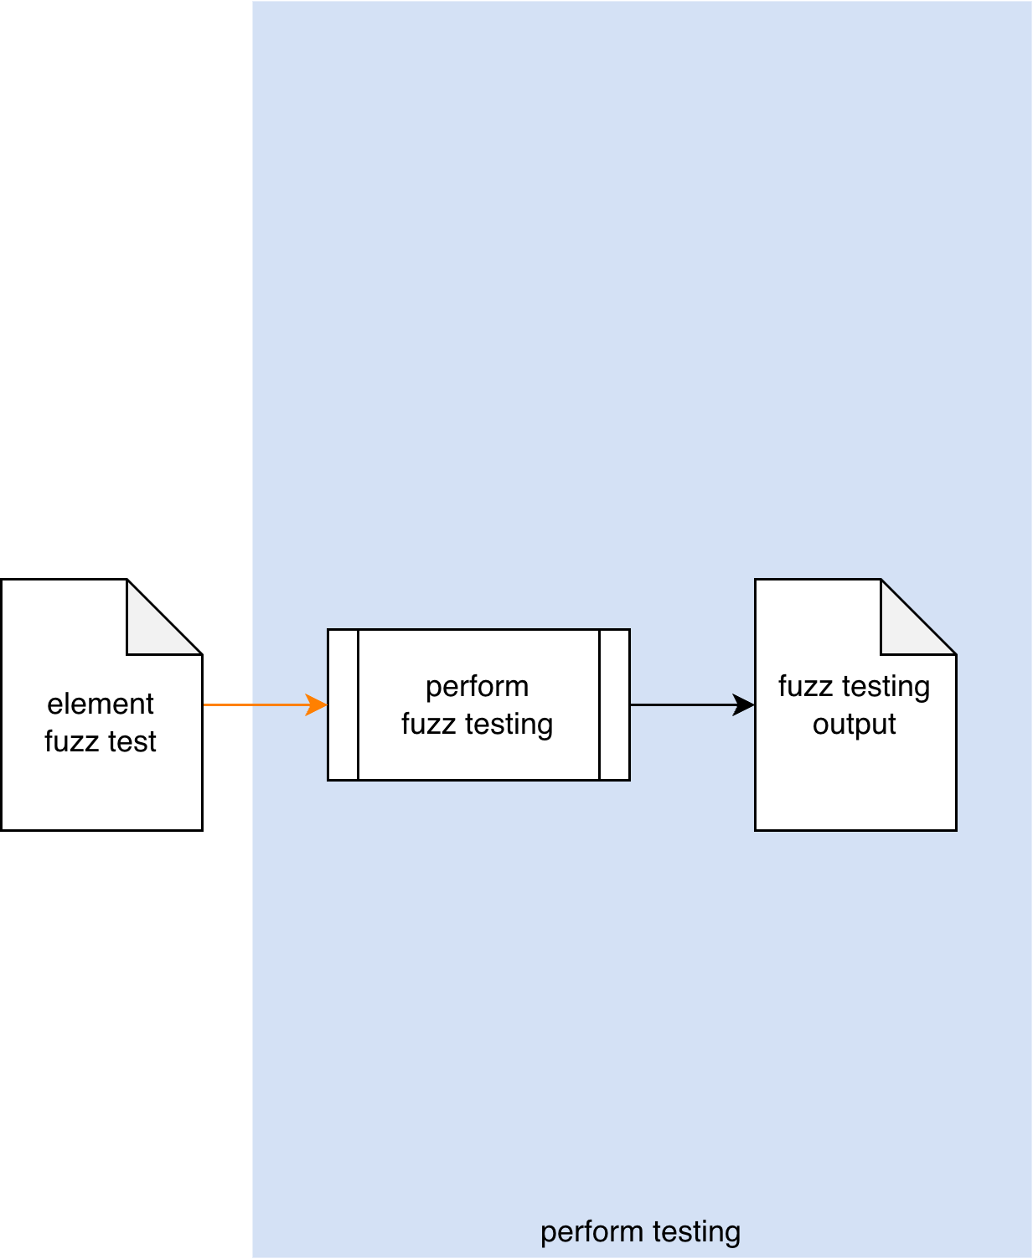
Process Workflow
Notes:
Script:
The workflow for performing the dynamic analysis process is broken down into four discrete activities.
These are:
• establishing the cybersecurity relevant settings
• instrumenting the element
• performing the analysis
and finally
• conducting a triage of the issues identified as a result of the analysis

Slide 13
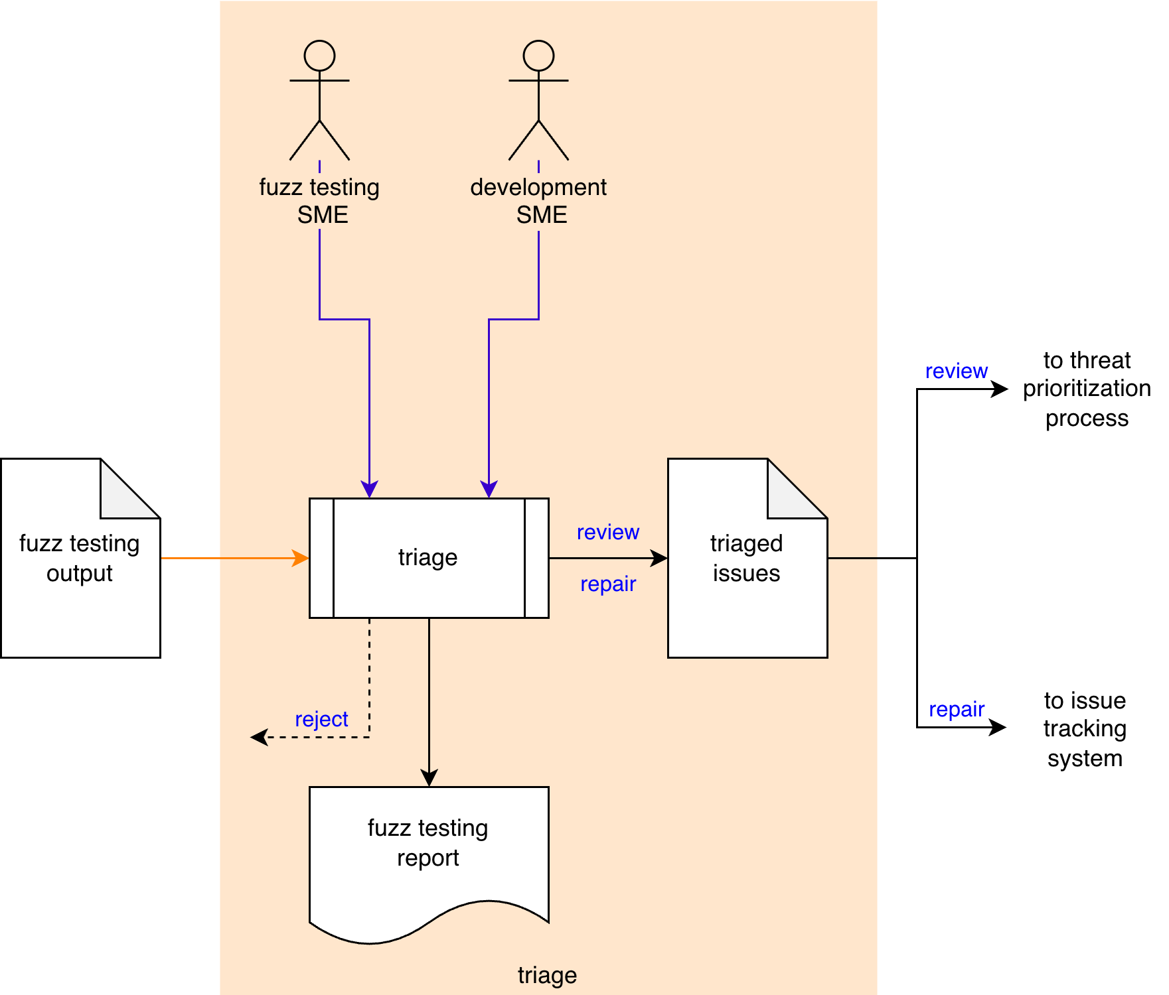
Process Workflow
Notes:
Script:
The workflow for performing the dynamic analysis process is broken down into four discrete activities.
These are:
• establishing the cybersecurity relevant settings
• instrumenting the element
• performing the analysis
and finally
• conducting a triage of the issues identified as a result of the analysis

Slide 14
Activities
Notes:
Script:
Let's now turn our attention to each of the activities that go into the fuzz testing process.

Slide 15
Establish Settings
Execution time
Footprint
Preflight
Notes:
Script:
Our first activity in the fuzz testing process is that of establishing the settings we'll use.
[pause]
The development SME,
[pause]
fuzz testing SME, and
[pause]
DevOps SME take
[pause]
the element,
[pause]
the build file, and
[pause]
the fuzz testing framework documentation and
[pause]
establish a set of settings to be used for fuzz testing.
These will be put into
[pause]
an updated build file.
And produce
[pause]
a security options qualifications report.
[pause]
If this diagram seems really information dense, that's because this is the encapsulation of the Secure Settings process.
We're not going to cover that here because we have a separate training for that.
[pause]
As a general note in the context of fuzz testing, we use this activity of settings establishment very loosely.
It includes any modifications to the build environment needed to enable fuzz testing.
This will be covered in greater detail in the Fuzz Testing – Establish Settings Procedure.
[pause]
As we're impacting the build, it's important to consider
[pause]
the execution time, and
[pause]
footprint.
The reason for this is that since fuzz testing is part of the test suite to be executed, it may be time-bounded.
And so, it's important to consider how that time-bounding will be impacted by the addition of fuzz testing.
The same is true for the footprint.
If you have instrumentation that's put into a test and attached to an element, regardless of what the scope of the element is, you may run into boundary conditions for the particular system the code is running on, and you have to be cognizant of that.
Finally, whenever you're making changes to the build system.
[pause]
be sure to preflight the build to ensure that the pieces that you're modifying or tooling you’re adding don't break the build.

Slide 16
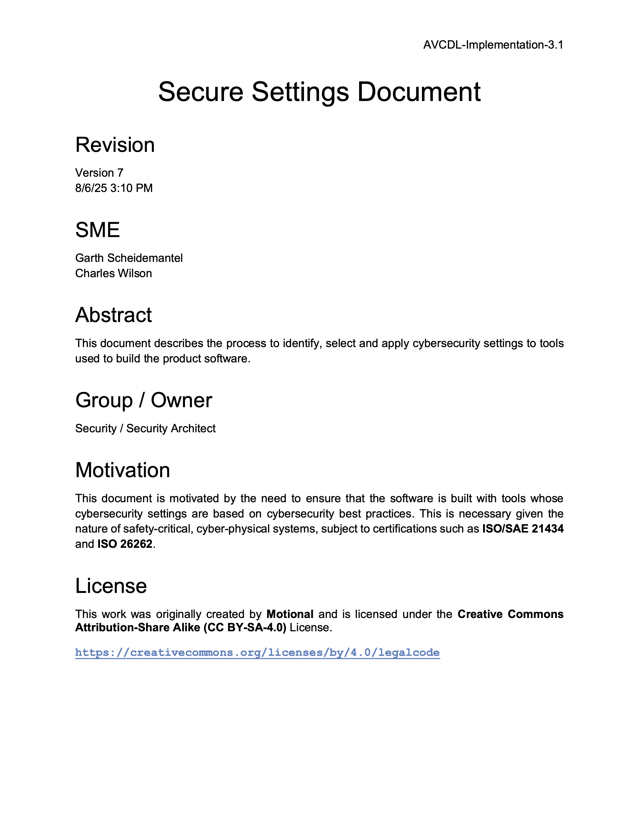
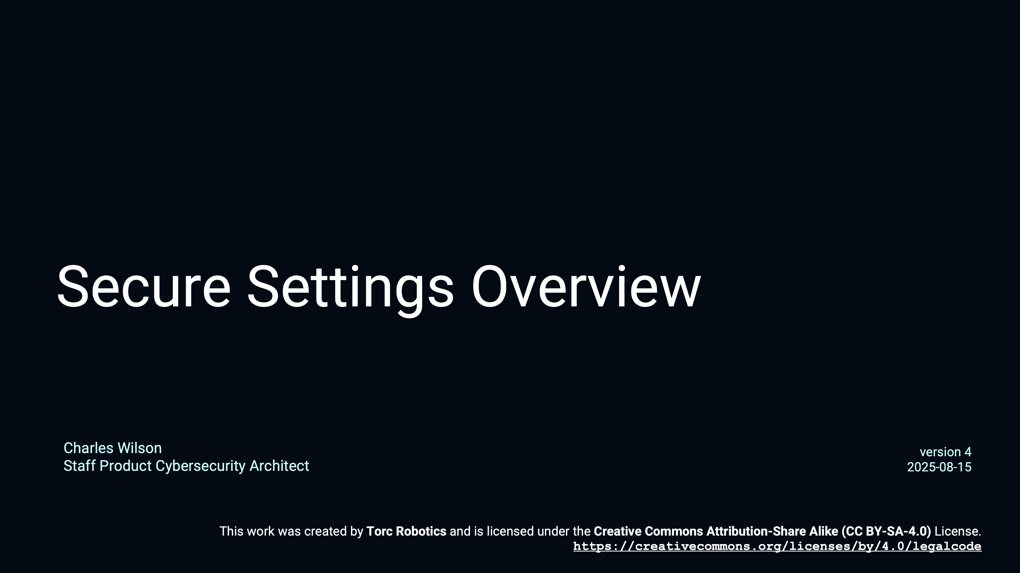
Secure Settings
Notes:
Script:
Coming back to the Secure Settings process for a moment, here are some references to review for more detail.
They are the Secure Settings Overview training video, and the Secure Settings Document, secondary document.

Slide 17
Create Test
Overlay existing test
Focus on cybersecurity
Tightly scope test
Possibly fully automated
Notes:
Script:
The next step in the fuzz testing process is to create the fuzz test.
[pause]
The fuzz testing SME and
[pause]
the DevOps SME take
[pause]
the updated build file and
[pause]
the element unit test and
[pause]
using them create
[pause]
an element fuzz test.
It's important to emphasize that generally we're simply
[pause]
copying an existing unit test and modifying it to allow the fuzz testing framework to run against the element.
Remember,
[pause]
our focus is specific to cybersecurity.
As with all unit testing,
[pause]
keep the test scope small.
[pause]
In some cases, this activity
[pause]
may be fully automated.
That's to say that given the build file with the updated settings and knowledge about the element we're intending to fuzz test,
It may be feasible to apply automation capable of using this information to generate fuzz tests.
[pause]
On the other hand, when there exists no unit test, one will need to be written.
Either way, it's important to recognize that tests don't magic themselves into existence.

Slide 18
Perform Testing
Failure modes
Resource impact
May be performed manually
Notes:
Script:
The third activity in the fuzz testing process is that of performing the test.
[pause]
The build system invokes
[pause]
the element fuzz test which
[pause]
performs the fuzz testing and generates
[pause]
fuzz testing output.
[pause]
Here we need to think about things like
[pause]
the failure modes.
Depending on how the fuzz testing framework has been utilized, you may have a simple failure such as “this was my expected result, and this is the result that I got.”
There could be an exception thrown that the framework catches.
Or the application could just crash.
[pause]
You have to consider all of these various cases when establishing the test.
[pause]
The next consideration is that of
[pause]
resource impact.
This was addressed in the Establish Settings activity, but it’s worth reiterating.
When we added the fuzz testing framework to the build system to enable its use, we considered the impact it would have on the build system’s resources.
Those being the time and space requirements of fuzz testing with respect to the overall build system constraints.
Those are definitely going to manifest here and we need to pay attention to that impact as we run the tests that we've created.
[pause]
The final thing to note here is that
[pause]
the testing may be performed manually.
This may seem obvious, but since there are no actors called out in this diagram, the anticipation may be that only the build system will execute these tests.
But as with all things which are automated, you first run the test manually and then automate it.

Slide 19
Triage
File issues immediately
False positives
Notes:
Script:
The final activity in the fuzz testing process, as with so many AVCDL processes, is that of triage.
[pause]
The fuzz testing SME and
[pause]
their development SME counterpart will take
[pause]
the fuzz testing output
[pause]
and triage it.
Any anomalous behavior needing further investigation is put into
a triaged issues list.
Which is then sent to the threat prioritization process.
[pause]
Finally, a fuzz testing report is generated.
[pause]
Some may consider having to put every issue through the threat prioritization process as excessive.
Depending on how the organization implements their processes, it is possible that
[pause]
issues may be entered directly into the issue tracking system instead of passing them to the threat prioritization process when the nature of the issue is unambiguous.
Additionally, if you're performing triage and discover that
[pause]
the tooling is reporting false positives, then you should review the fuzz test and update it appropriately.

Slide 20
Fuzz Testing Report
tooling
element
results
Notes:
Script:
There are three essential pieces of information needed in the fuzz testing report.
[pause]
The first is the tooling, that is the fuzz testing framework employed.
This may seem nonessential but consider that there's not just one fuzz testing report that will ever be generated, there are a multitude of them.
And as this information progresses through the threat prioritization process, and is entered into the issue tracking system, even as it's read, it's critical to know the specific tooling being used.
This extends beyond just its name.
There's a whole host of information needed to identify what was used to perform the analysis.
[pause]
The next thing to consider is the documentation of the element.
You may have chosen the scope, and conducted the testing based on that scope, but it's important that this be documented in a way that allows others to easily locate it.
[pause]
Finally, we have the results.
Keep in mind that there may only be one issue depending on the failure modes in use.
[pause]
The takeaway is that we need to ensure that we're including all information necessary for someone to both replicate and resolve the issues.

Slide 21
Recap
Notes:
Script:
That's an overview of the process used in performing fuzz testing.
Now let's review what we’ve covered.

Slide 22
Summary
Select and enable the tooling
Build the test (cybersecurity focused)
Run the test
Triage the results
Report the findings
Notes:
Script:
When we undertake fuzz testing, we want to first
[pause]
select and enable the tooling.
Next,
[pause]
we build the test, keeping in mind that it needs to be
[pause]
cybersecurity focused.
[pause]
We then run the test,
[pause]
Triage the results, and finally
[pause]
report the findings.

Slide 23
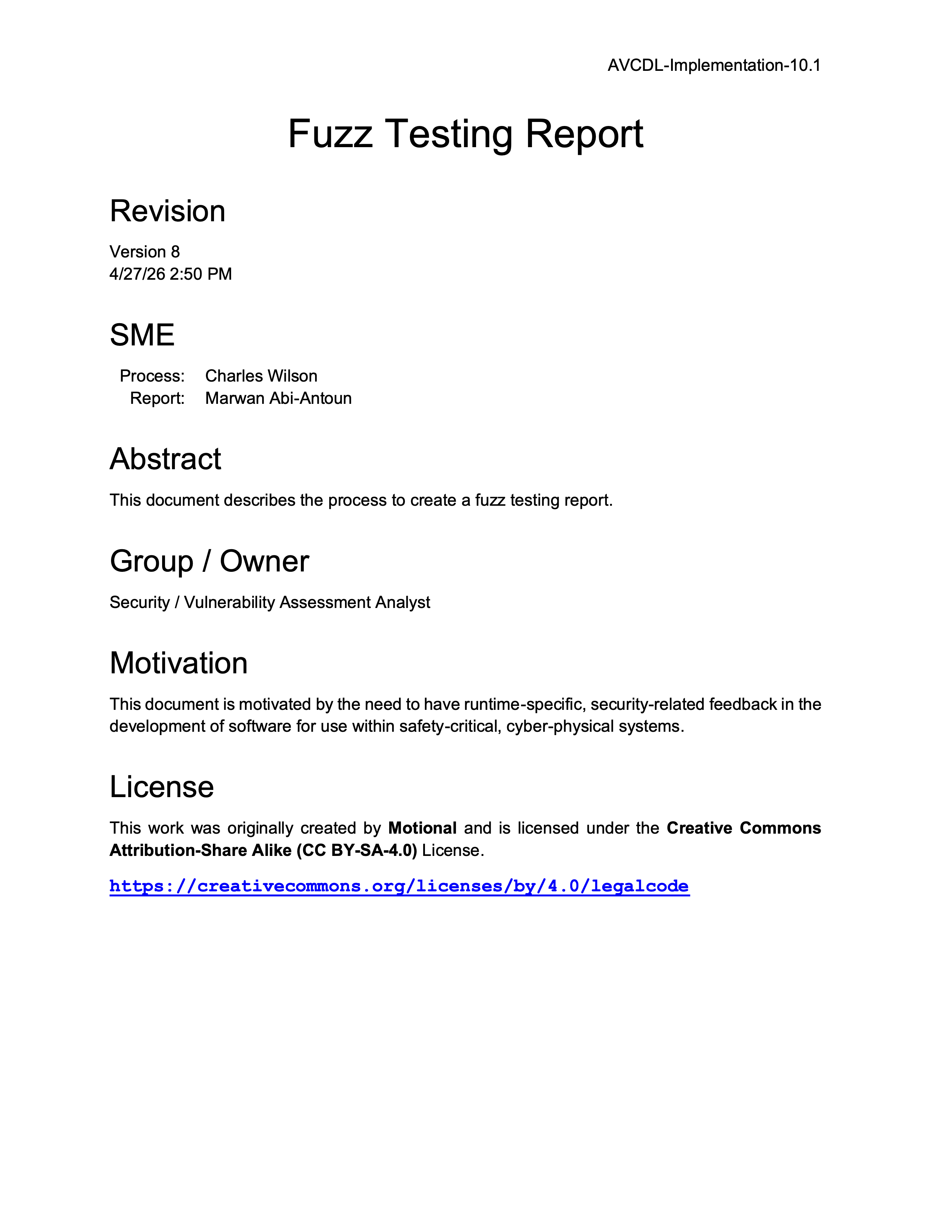
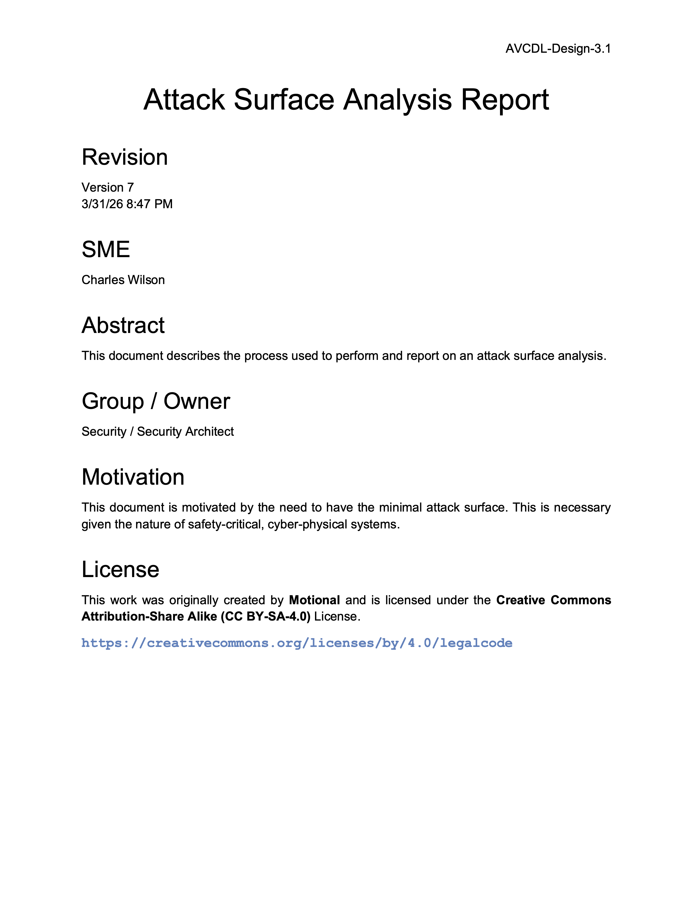
Further Reading
Notes:
Script:
For more information, and to get a more in-depth set of references, the Fuzz Testing Report and Attack Surface Analysis Report secondary documents are available in the AVCDL GitHub repository.

Slide 24
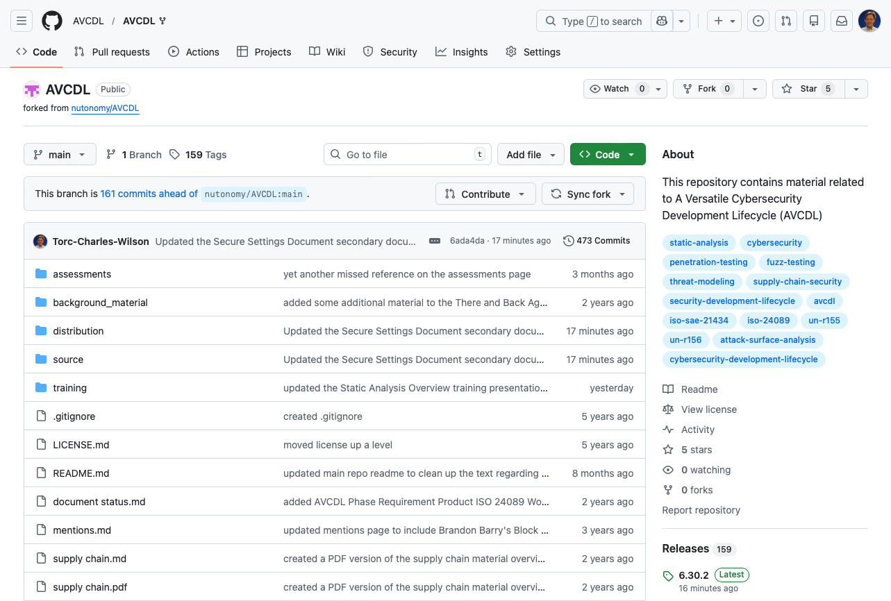
AVCDL on GitHub
https://github.com/AVCDL/AVCDL
Notes:
Script:
All AVCDL materials, both in source and distribution forms, are available on our GitHub site, as shown here.
Because of the size of the repository, it's recommended that you either clone the repository or download a ZIP archive of it, if you're not familiar with using git.
Instructions for downloading a ZIP archive are linked to on the repository’s front page.

Slide 25
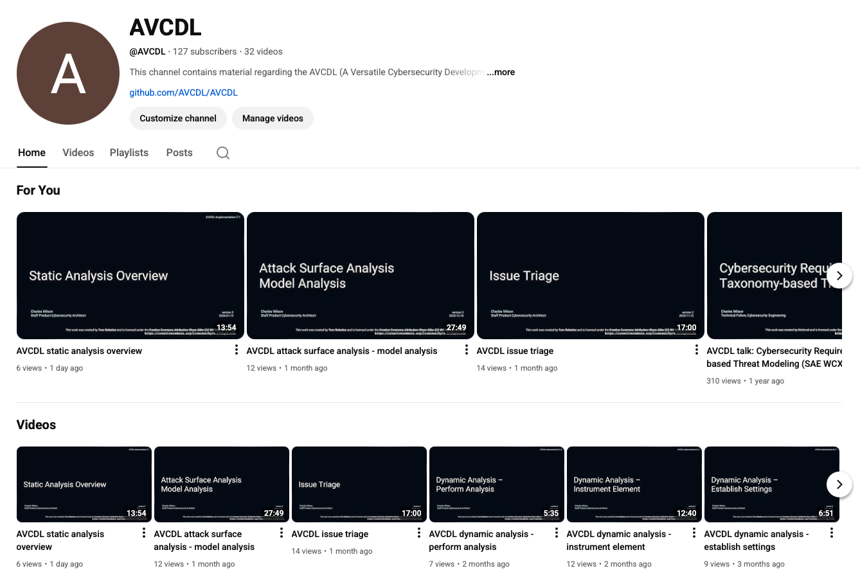
AVCDL on YouTube
https://youtube.com/@AVCDL
Notes:
Script:
Videos covering various aspects of the AVCDL are available on our YouTube channel, as shown here.
It's important to note that all AVCDL materials with the exception of the introductory blog posts are intended for product cybersecurity engineering practitioners.

Slide 26
Next Steps
Notes:
Script:
With this training complete, if you’ve completed the other trainings covering the Fuzz Testing process activities, you can proceed to the other trainings at this level, these include:
Static Analysis
Dynamic Analysis
and
Secure Code Review

Slide 27
References (1 of 2)
AVCDL primary document
Fuzz Testing Report (AVCDL secondary document)
Secure Settings Document (AVCDL secondary document)
Attack Surface Analysis Report (AVCDL secondary document)
Threat Prioritization Plan (AVCDL secondary document)
Report Generation (AVCDL elaboration document)
Static Analysis Results Interchange Format (SARIF) Version 2.1.0
https://docs.oasis-open.org/sarif/sarif/v2.1.0/os/sarif-v2.1.0-os.pdf
Common Weakness Enumeration (CWE)
https://cwe.mitre.org/
Fuzzing
https://en.wikipedia.org/wiki/Fuzzing
Unit Testing
https://en.wikipedia.org/wiki/Unit_testing
Notes:
Script:
Here are the references to the source material used in the creation of this presentation.
They'll also be included in the video description.
Additionally, this presentation’s source material will be provided on the AVCDL GitHub repository.

Slide 28
References (2 of 2)
Roulette ball [Ralf Roletschek] (CC-BY-SA 3.0)
https://commons.wikimedia.org/wiki/File:13-02-27-spielbank-wiesbaden-by-RalfR-094.jpg
Setup at the start of a chess game [Bubba73] (CC-BY-SA 3.0)
https://commons.wikimedia.org/wiki/File:13-02-27-spielbank-wiesbaden-by-RalfR-094.jpg
Notes:
Script:
Here are the references to the source material used in the creation of this presentation.
They'll also be included in the video description.
Additionally, this presentation’s source material will be provided on the AVCDL GitHub repository.

